Slide 1
Cryptocurrency Market Analysis
Team 2
Apurwa Prasad
Anthony Renzullo
Xinyin Miao
Kumari Juhi

Slide 2

Introduction
What is cryptocurrency?
A digital or virtual currency that uses cryptography for security. Transactions are recorded on blockchain (digital public ledger) encrypted using cryptography
Advantages:
Built on Blockchain
Fraud free and safer
Immediate settlement
Lower fees
Decentralized
Disadvantages:
Not all companies accept it
People still skeptical
If lost, can’t be recovered
Transactions can’t be traced
Notes:
Examples – Many heavy computational techniques have been used for price prediction – Neural Networks, Deep learning, etc.
Bithumb's hack took place on June 19, with about $30 million in tokens stolen
In January, the Japanese exchange Coincheck suffered an attack which cost it 523 million NEM coins valued at about $534 million
Link: https://www.investopedia.com/news/largest-cryptocurrency-hacks-so-far-year/

Slide 3

Business Problem and Proposed Solution
Business Problem
Analyze data and trends to predict the closing price of top cryptocurrencies for good investment strategies

Slide 4
Literature
Cryptocurrencies have garnered interest for scholars and data scientists to try and predict the volatile market
Quantitative Analyses
Time-series
Sentiment Analyses
Classification
Gradient boosting tree
How do we differ?
Focus on correlations
Log transformations
Linear regressions

Slide 5
Data Description
Dataset consists of price records for ~ 1,350 different cryptocurrencies on a daily basis
Cryptocurrencies on a daily basis from Apr-2013 to Jan-2018, comprising of ~651k records
Consists of 9 variables – 8 Numerical and 1 Categorical
Date - the day of recorded values
Open - the opening price (in USD)
High - the highest price (in USD)
Low - the lowest price (in USD)
Close - the closing price (in USD)
Volume - total exchanged volume (in USD)
Market Cap - the total market capitalization for the coin
Coin - the name of the coin
Delta - calculated as (Close - Open) / Open
Data Distribution using:
matplotlib.pyplot
seaborn

Slide 6
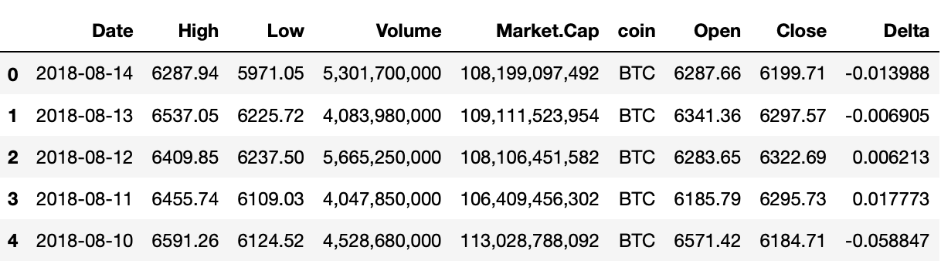
Data Description
Data Source: Kaggle- Cryptocoins Historical Prices
Target Variable: Close

Slide 7
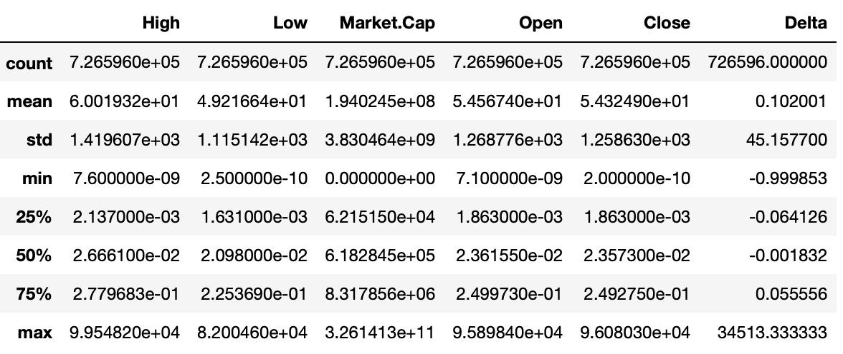
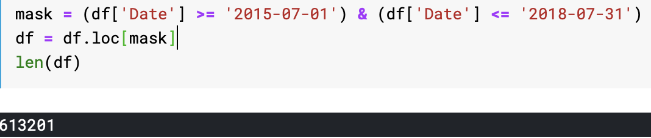
Data Description
Summary of dataset
Filtering 3 Years of data
Notes:
Basic stats of dataset has been shown here. Market Cap and Volume are in millions as compared to other price variables which are in thousands. This hints us towards standardizing variables before using in any model which is affected by different scales of the variables.
We have filtered 3 most recent years of data for our further analysis – Jul 2015 to Jul 2018.

Slide 8
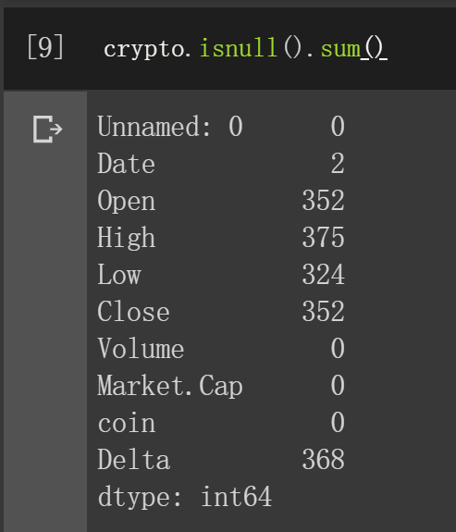
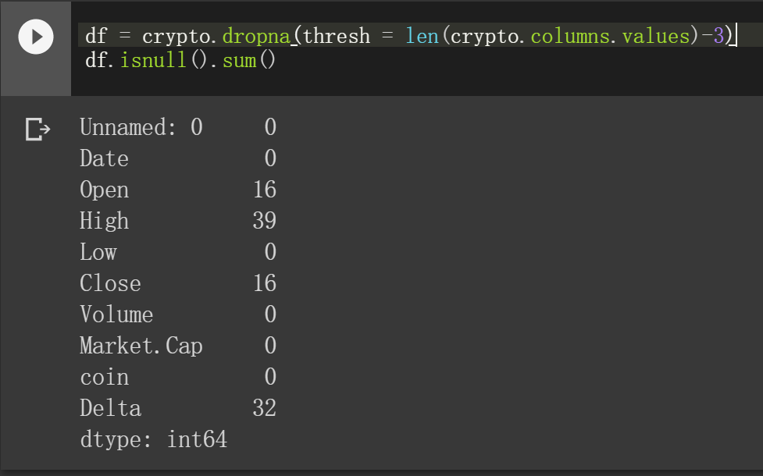
Data Exploration
1. Missing values account for less than 1%
2. Remove all useless records
Notes:
There are less than 1% missing values in the dataset which were removed from the data

Slide 9
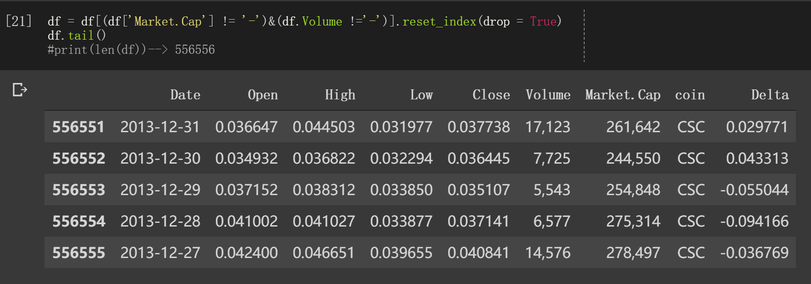
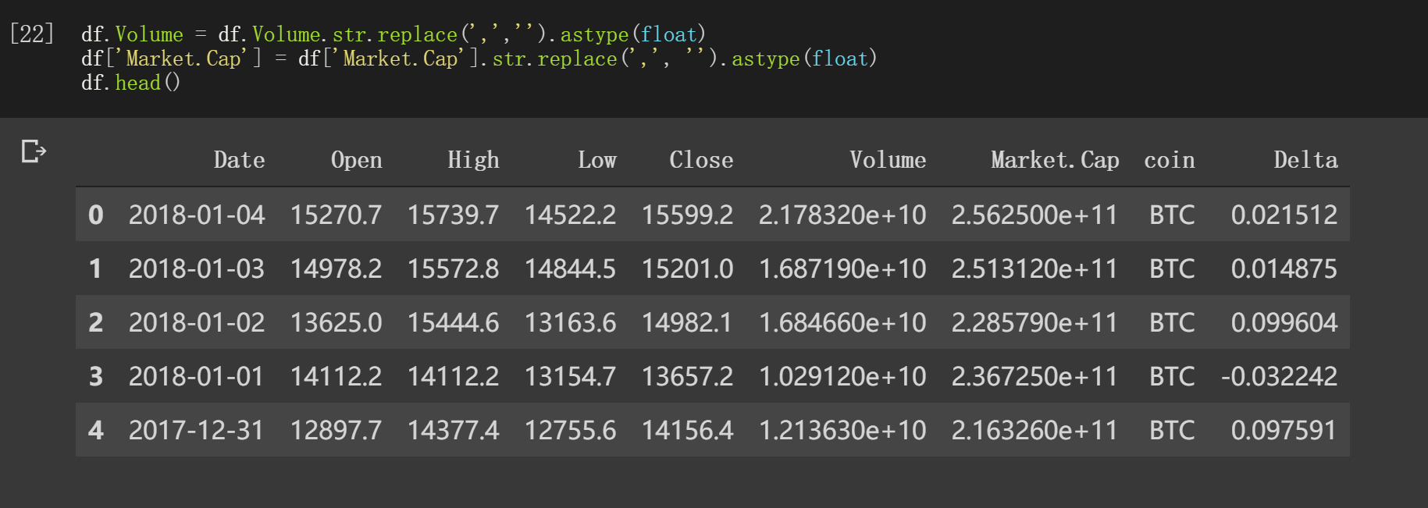
Data Exploration
3. Remove trash data in two columns:
’Market.Cap’ & ‘Volume’
4. Also convert Str → Float

Slide 10
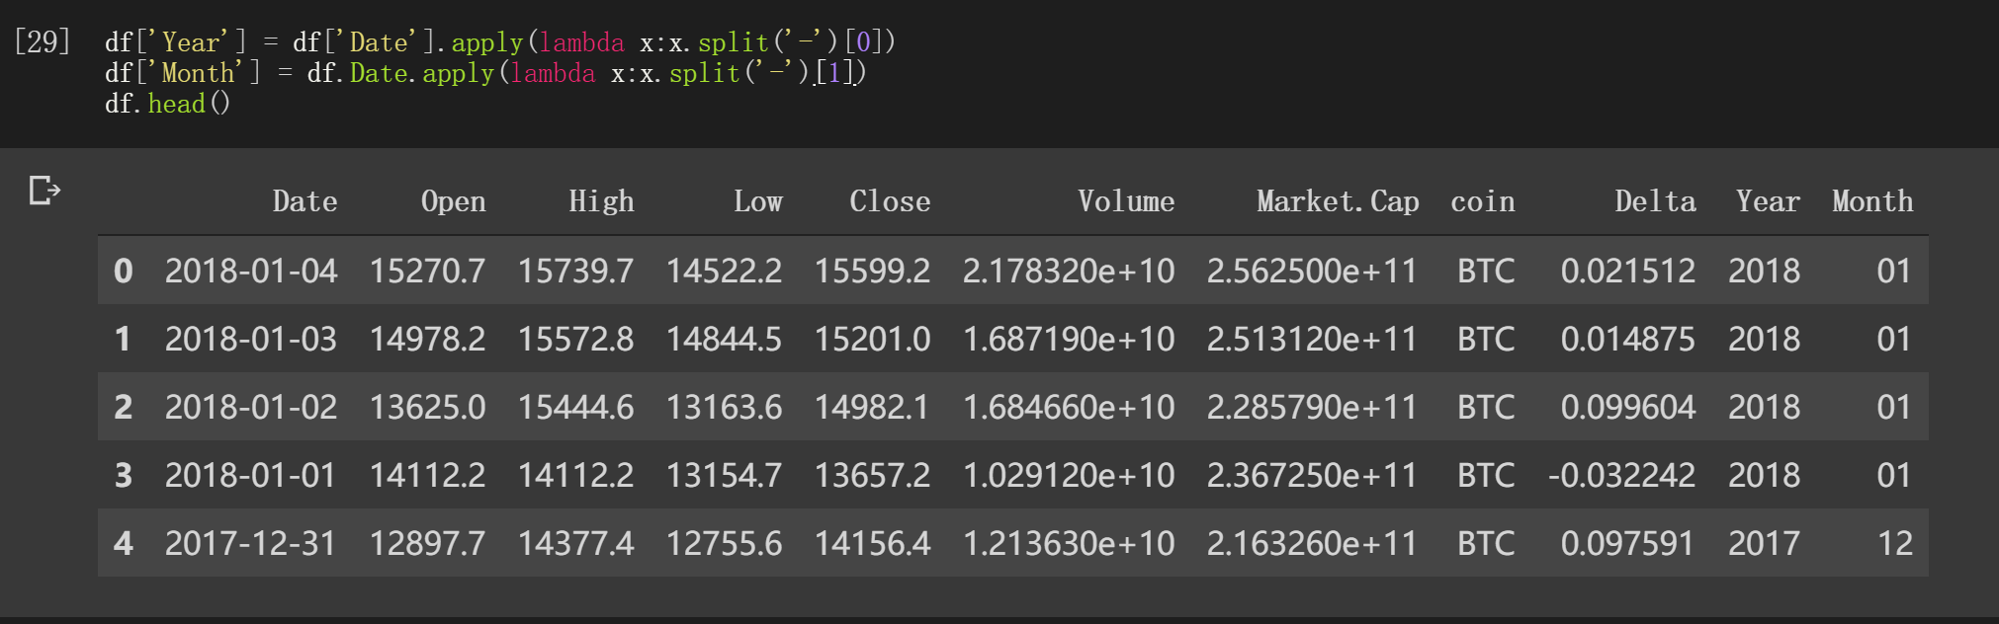
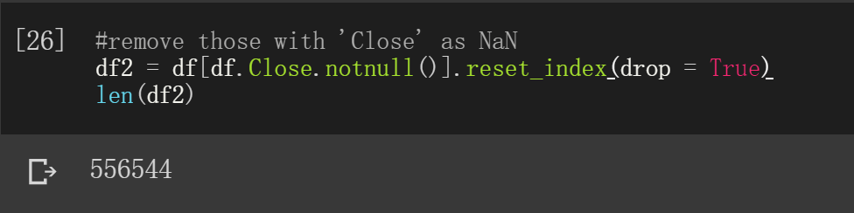
Data Exploration
5. Add ‘Month’ and ‘Year’
6. Rows without Target are trash data

Slide 11
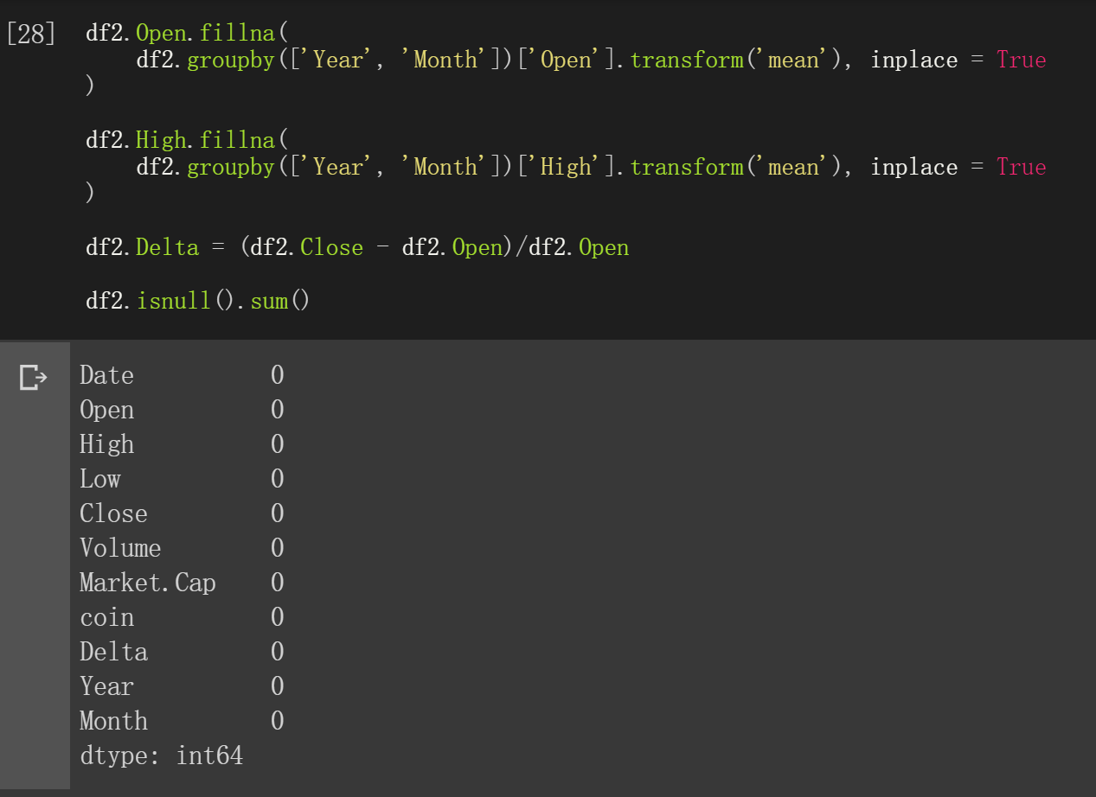
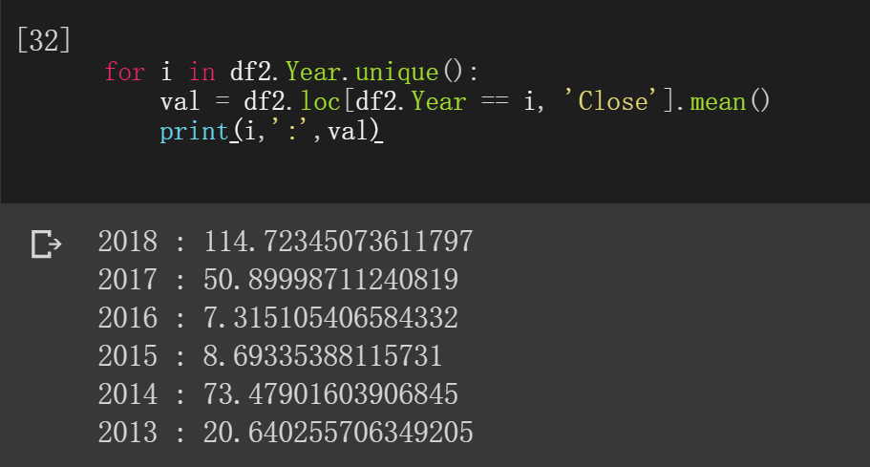
Data Exploration
7. ‘Close’ in Different Years has different level
8. Fill missing values based on Time
9. The data is cleaned!

Slide 12
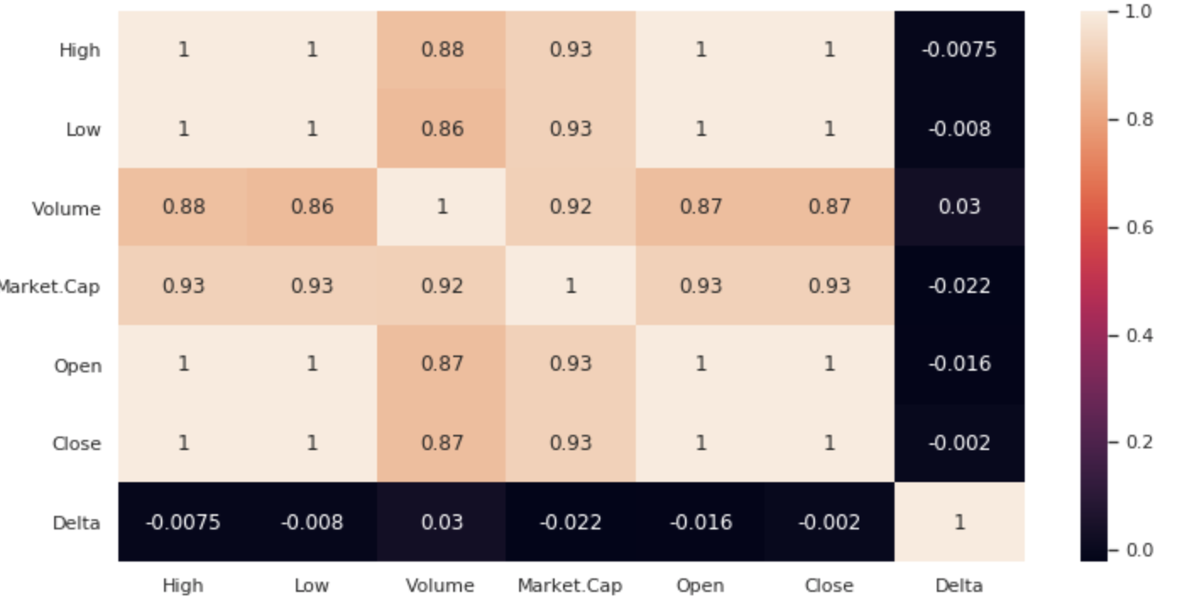
Data Exploration
Correlation Matrix
Highest Correlation between:
Close & High
Close & Low
Close & Open
Notes:
As shown in the correlation plot, Open, High and Low variables have a correlation of 1 with the target variable (Close). Market Cap and Volume also have very high correlation with Closing price. Hence, we can use either only one of these or all the variables for modelling. Delta doesn’t have any significant correlation with price. Hence, this variable can be dropped from analysis.

Slide 13
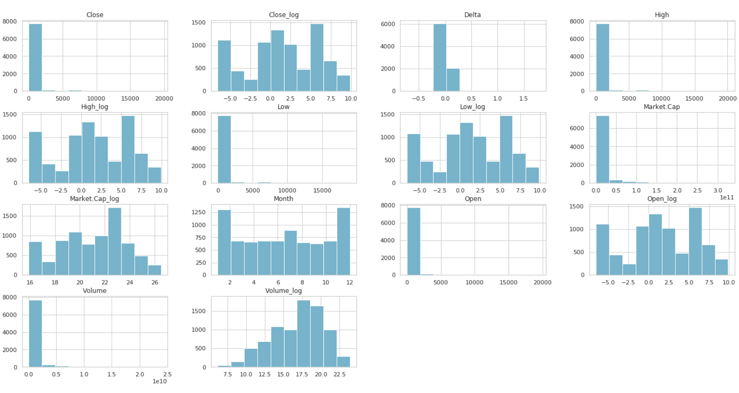
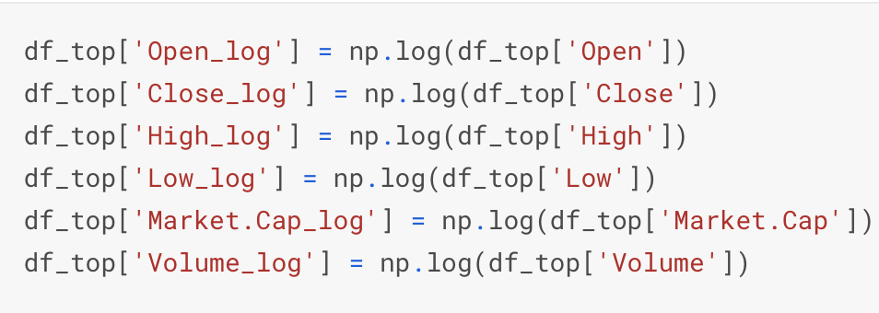
Data Transformation Performed
Converting non-numeric features into numeric
Normalized numeric features (most models perform better afterwards).
Transforming prior to training
Notes:
Based on the distribution shown for original variables, we can try transforming data to shape the distribution from highly skewed to less skewed distribution. This will help in understanding the effect of change in the variable’s value on Close price.

Slide 14
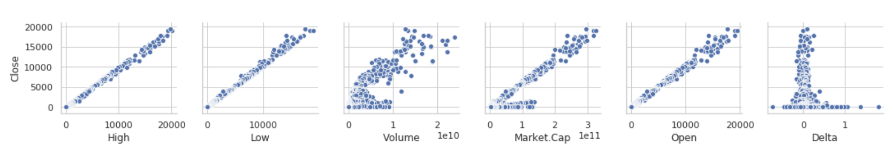
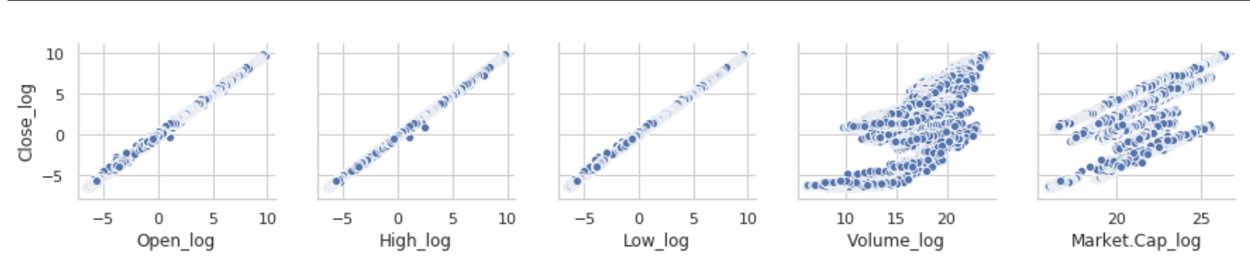
Data Transformation Performed
Notes:
As shown here, Scatter plot further confirms the linear relationship of Close price with Open, High and low variables while Market cap is not having a very strong linear relationship as compared to the other 3 variables. After log transformation, the relation can be seen getting much stronger than before. While Volume and Market Cap transformed variables are not having a linear relationship as compared to others

Slide 15
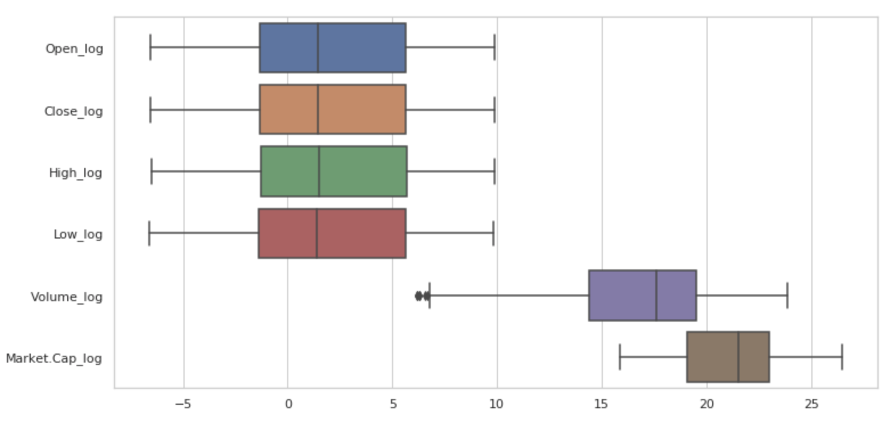
Data Transformation Performed
Boxplot of all variables after log transformation
Notes:
After log transformation, as seen here, except Market Cap and Volume, all the other variables have very similar distribution. Volume might have few outliers in it but we can check further if we need to remove or impute those outliers.

Slide 16
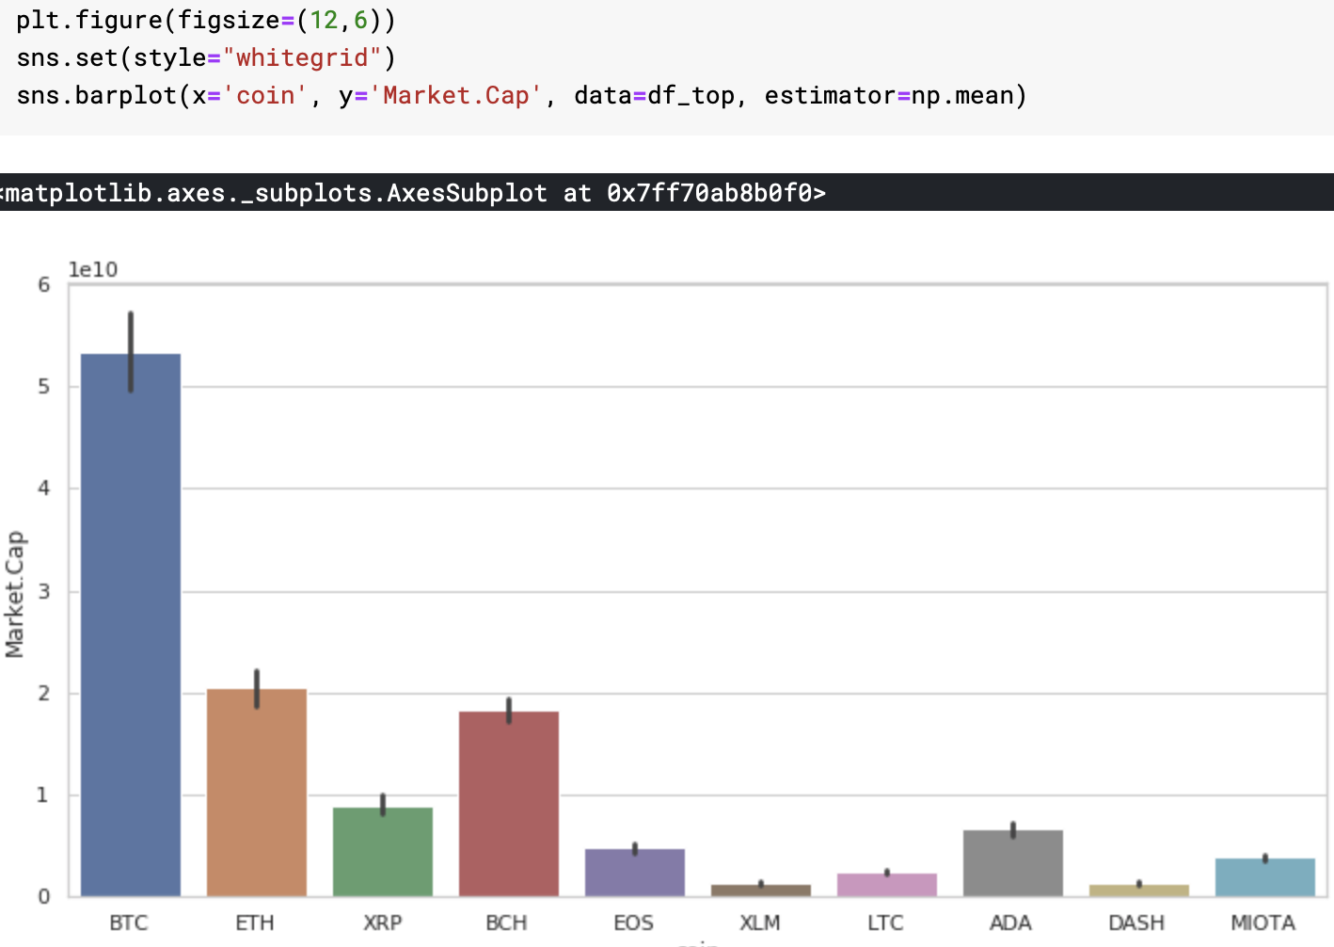
Top Four Coins Found
Bitcoin
Ethereum
Bitcoin Cash
Ripple
Notes:
We have filtered our dataset from Jul 2015 to Jul 2018 for top 10 coins only based on their Market Cap value. They are Bitcoin, Bitcoin Cash, Ethereum and Ripple. The later 2 are newer coins and cheaper as well than Bitcoin and Bitcoin Cash. Another popular coin is Litecoin whose Market Cap value as of last 3 years of data suggests, is not enough to make it to the top 4 coins. It’s value must have dropped from before.

Slide 17
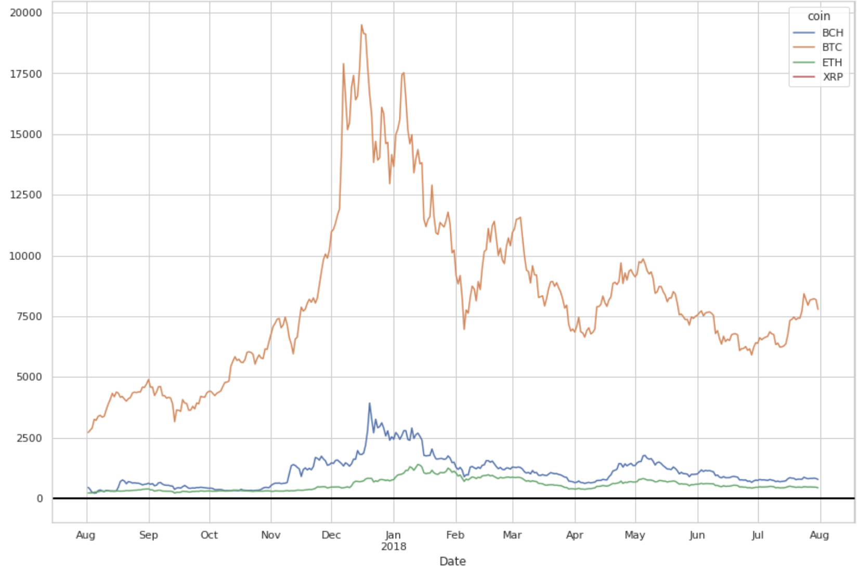
Top Four Coins Found
Close Price for top four coins
(Past year)
Notes:
Based on the Closing price distribution for last 1 year for top 4 coins, Bitcoin, as expected, has the highest value among all. It saw a steep increase and decrease in the price from 2017 end to 2018 mid year. This market fluctuation affected other coins in the same fashion. But currently, the newer coins are also promising as their values are consistent for a period of time.

Slide 18

Predictive Modeling
Notes:
Now we have explored our dataset and cleaned it according. We have also transformed it based on the results of our exploration. We can move next to model our data to predict Closing price of the top 4 coins in the market.

Slide 19
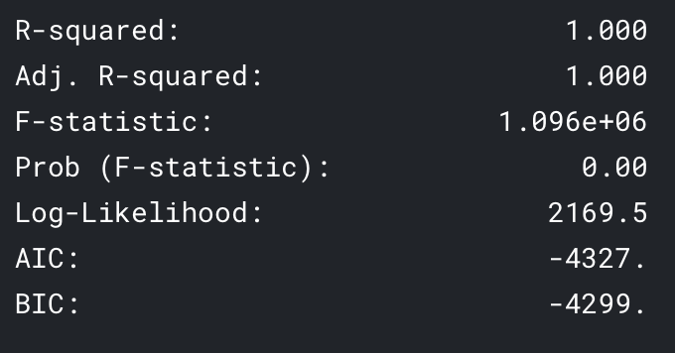
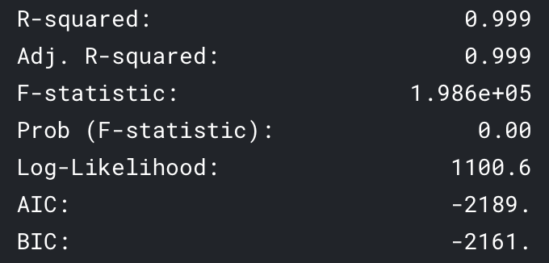
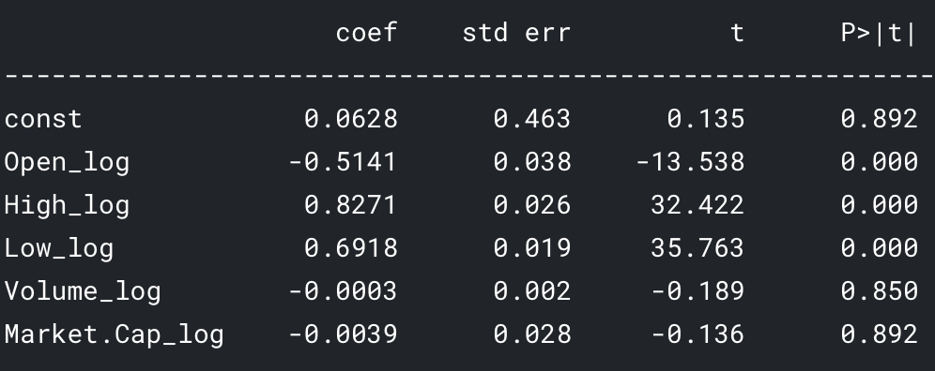
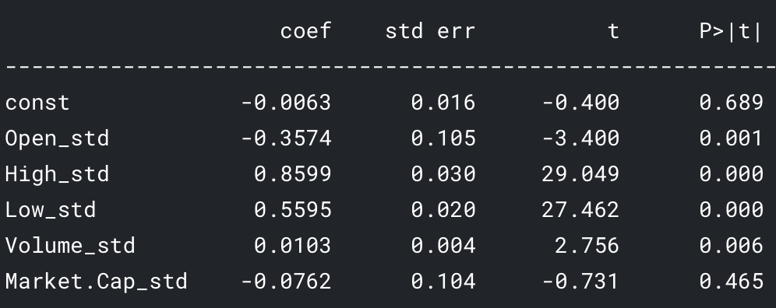
Model- Bitcoin
With all log transformed Variables
With all standardized Variables
Notes:
With all log transformed variables in linear regression model, Volume and Market Cap are not very significant for predicting Close price. Even with only standardized columns, the results are pretty similar. Accuracy is very high, suggesting we might even don’t need a regression model to predict price. We can just keep a close eye on the High and Low prices of each coin.
For log-transformed model, it shows that 1% increase in High price would yield an increase of 0.83% in the Closing price. Similarly, we can interpret for other variables.
For standardized variables, it represents that 1unit change in std deviation of the High value will lead to an increase of 0.859 std deviation in the Closing price.

Slide 20
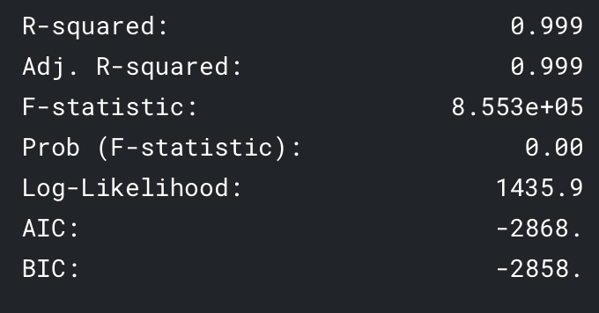
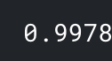
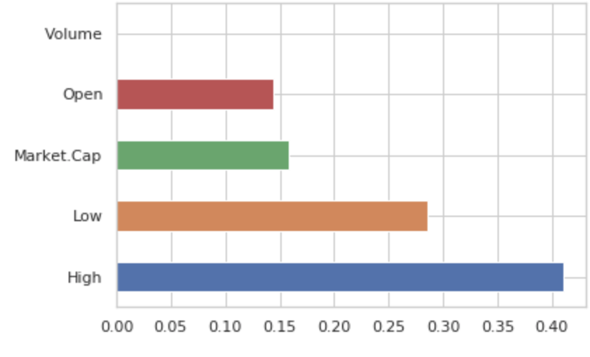
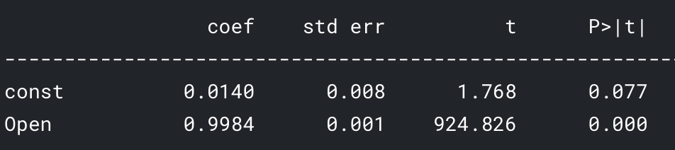
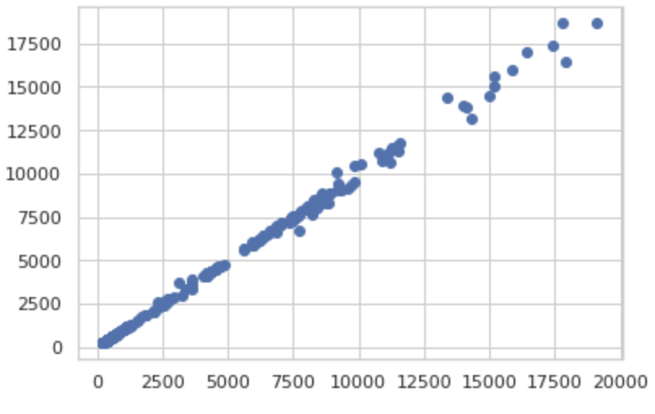
Model Bitcoin
With only Open as predictor variable
With all Original variables-Random Forest
R square
Feature
Importance
Plot
Predicted
Vs
Actual
Notes:
With only Open as a predictor in linear regression model for BTC , the accuracy is still very high. When trying Random Forest regressor for this problem, the feature importance plot shows High and Low and Market cap as the important variable contributing to the model. The accuracy was similar to linear regression outputs. The scatter plot also shows that the predicted prices are pretty close to the original price.
As seen from the summary of the linear model, a unit increase in the Open price will lead to 0.99 unit increase in the Closing price of Bitcoin.

Slide 21
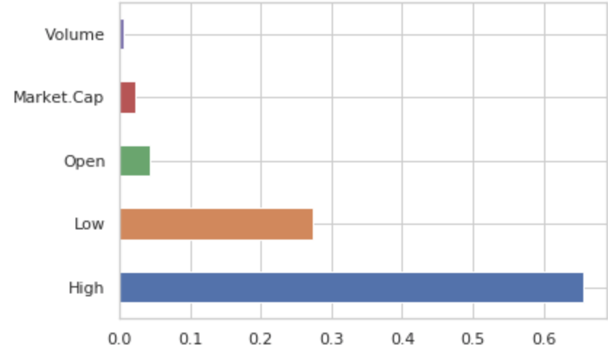
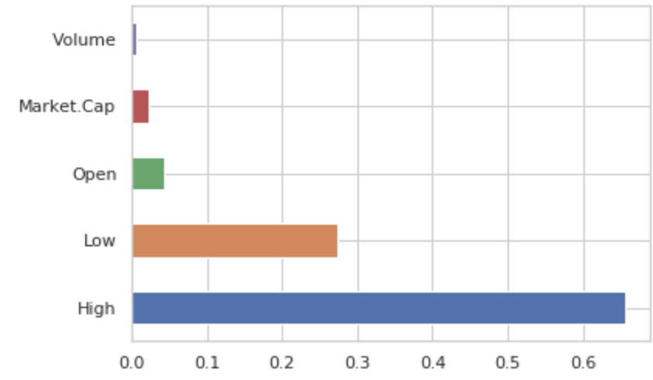
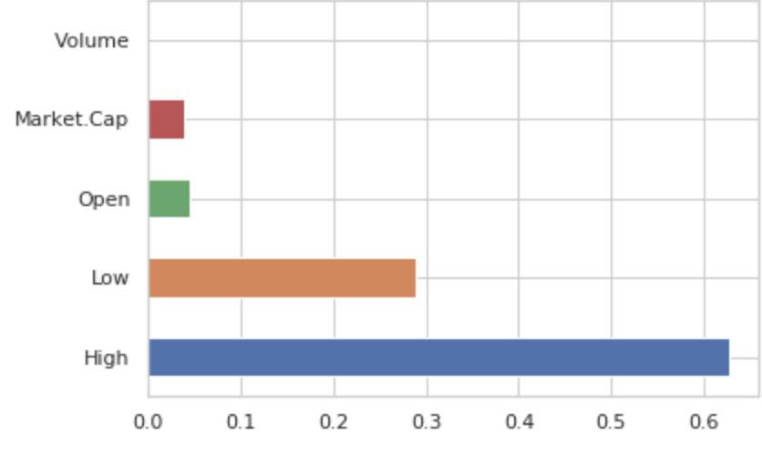
Random Forest- Feature Importance Plot
Ethereum
Bitcoin
Cash
High and Low are the major factors in determining the Closing price of the coin with little contribution from the Open price
Ripple
Notes:
Random forest was tried on the remaining 3 top coins after BTC and similar results were obtained. The feature importance plot gives the importance of the variables tried in the model. Hence, Closing price is closely related to High, Low and somewhat on the Open price as well.

Slide 22
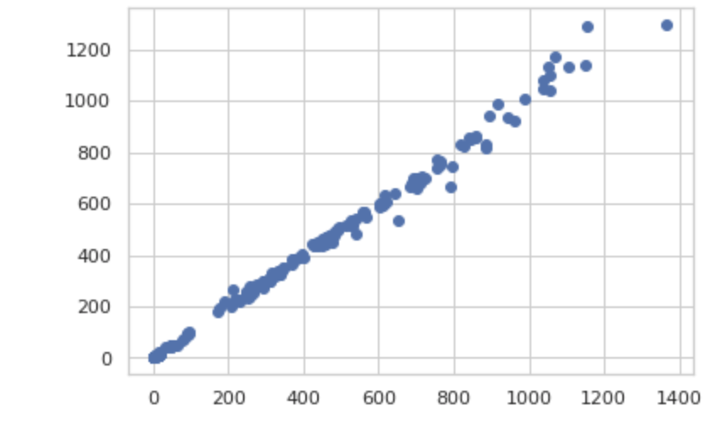
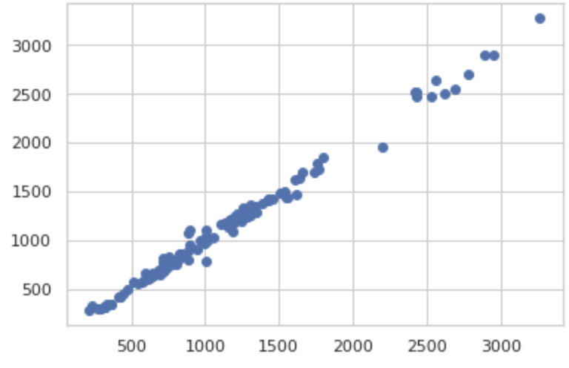
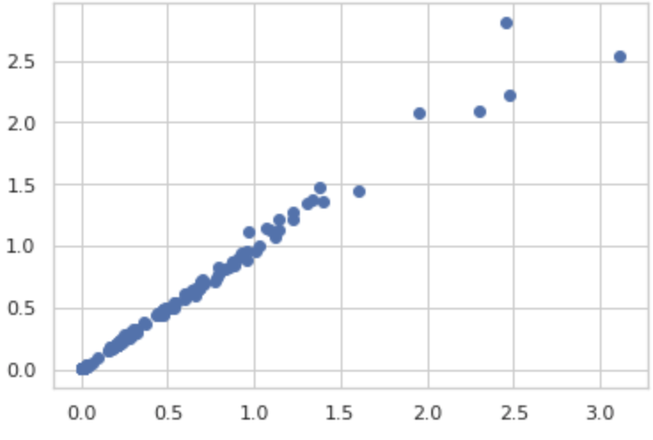
Random Forest- Predicting Closing Price
Ethereum
Bitcoin
Cash
Random Forest model works equally good in predicting the Closing price of the coins
There’s little variation in Closing price prediction for Ripple and Bitcoin Cash
Ripple
Notes:
As shown here, the scatter plots between predicted and test shows a very good linear relationship is getting captured by the model for all 3 of them.

Slide 23
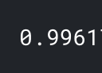
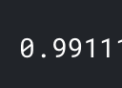
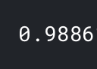
Random Forest- R Square
Ethereum
Bitcoin
Cash
R-square values for Random Forest models for the three coins performs well in predicting the Closing price
Ripple
Notes:
The accuracies for each model tried is similar to each other and is very high ~99%.

Slide 24
Model Comparison
 | Model | Variables Used | Variable modification | R square
Bitcoin | Linear Regression | With all log transformed Variables- Open, High, Low, Volume, Market.Cap | Log transformation | 100%
 |  | With standardized Variables-Open, High, Low, Volume, Market.Cap | Standardized variables | 99.99%
 |  | Open | Original variable | 99.99%
 | Random Forest | Open, High, Low, Volume, Market.Cap | None | 99.78%
Bitcoin Cash | Random Forest | Open, High, Low, Volume, Market.Cap | None | 99.11%
Ethereum | Random Forest | Open, High, Low, Volume, Market.Cap | None | 99.61%
Ripple | Random Forest | Open, High, Low, Volume, Market.Cap | None | 98.86%
Notes:
Different models and their output has been listed here.

Slide 25
Findings
Both Linear Regression as well as Random Forest regressor models perform well in predicting Closing price for top 4 coins
Closing price for BTC, ETH, XRP and BCH depends on High, Low and to some extent, on the Opening price as well
Even with a single variable (Open) for BTC, we get about 100% accuracy from Linear regression model
Notes:
Keep a close watch on the High and Low values to effectively estimate the Closing price of the coin for that day. Also, the Open price also gives a fair estimate as to what to expect for the close price.

Slide 26
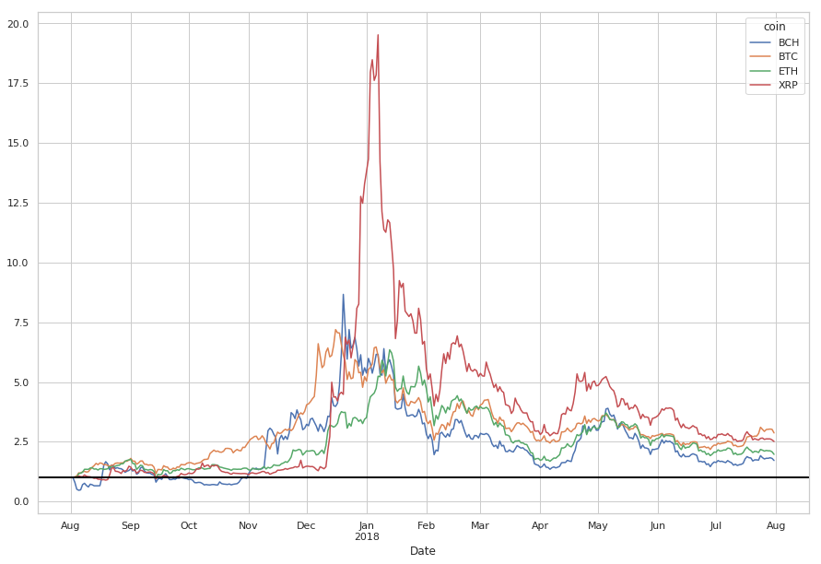
Recommendations For Business
Keep a close watch on the High and Low price for a coin to estimate the Closing price for that day
Open price can also be taken into consideration to compare the close price estimate for different coins for that day
How much to expect in return if using Buy & Hold Strategy?
Notes:
Ripple has the highest return as compared to the other top coins. Currently, it is the cheapest coin out of top 4 coins and with increasing market trend, it is promising to see very high return for ripple. Let’s check the % increase in return and how much are we expecting to make out of it.

Slide 27
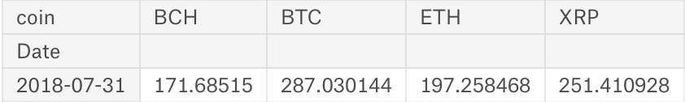
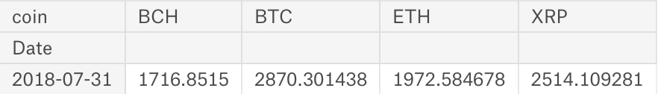
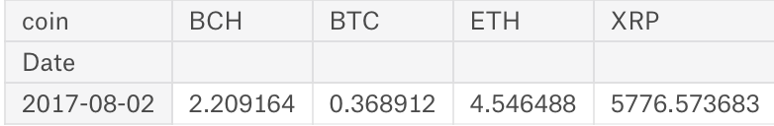
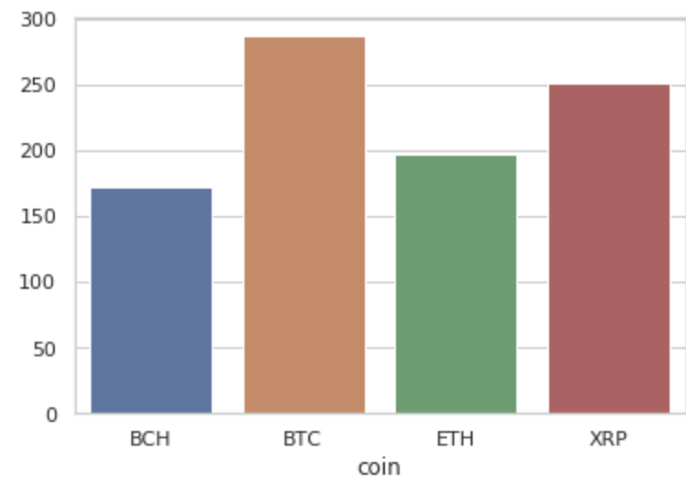
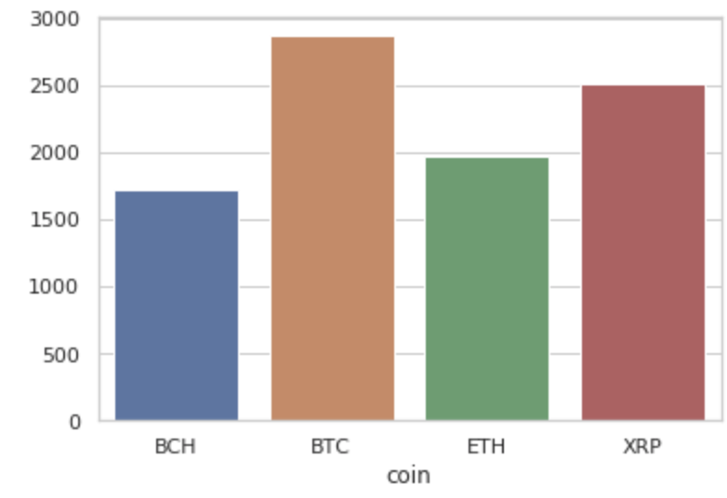
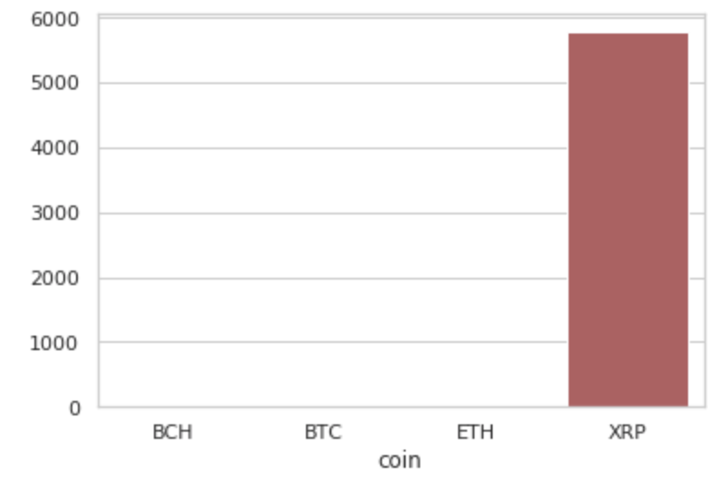
Recommendations For Business
What is the percentage increase in return?
How much money would we make?
How many coins can be bought with $1000?

Slide 28
What would you like to buy?

Slide 29
Thank You!
We are open for questions

